Slide 1
Hybrid Programing with MPI + OpenMP
Bruno Costa Rendón
High-Performance Computing
Fall 2017

Slide 2
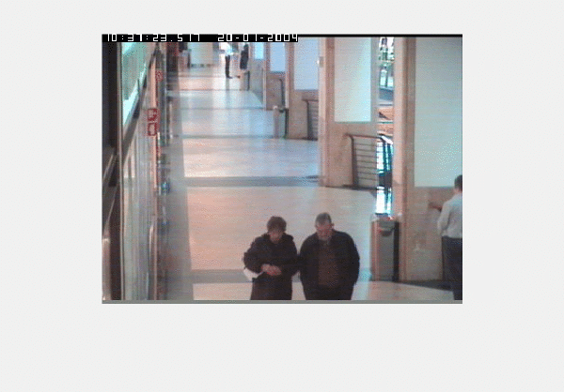
Motion detection
Steps:
(1) Smooth
(2) Temporal Derivative
(3) Normalize with threshold
Frames: 485
Rows: 288
Columns: 384

Slide 3
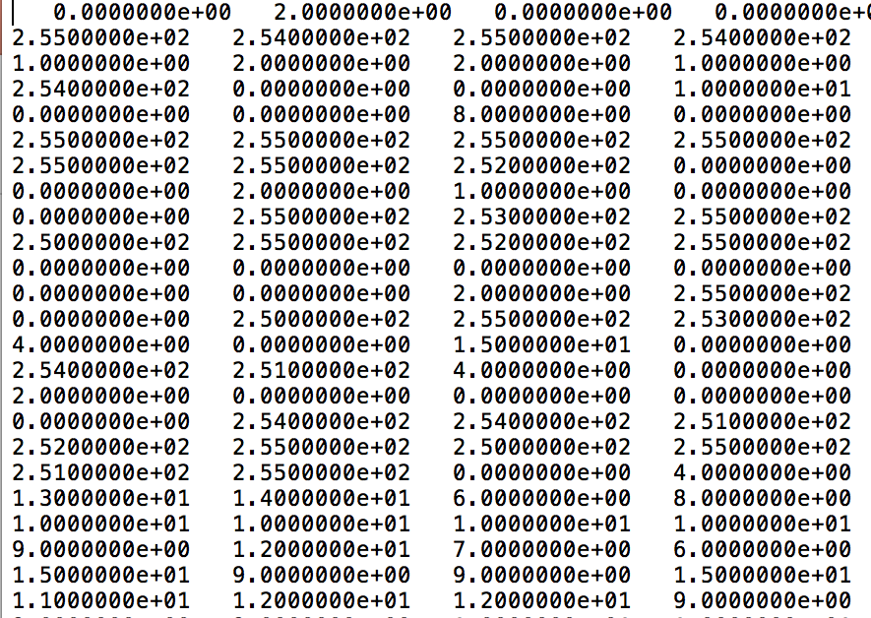
Project Objectives
Project Requirements
Optimize number of cores.
Optimize number of threads.
Optimize workload per thread.
Exploit temporal locality.
Apply workload balances.
Gray text values of images.

Slide 4
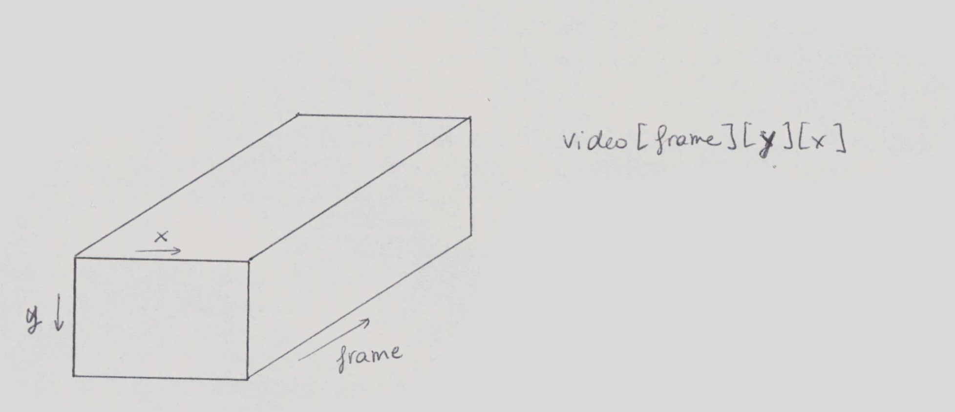
Data structure

Slide 5
Creating 3D array
int ***video = new int **[FRAMES_PER_RANK];
for(int i = 0; i < FRAMES_PER_RANK; i++) {
video[i] = new int*[ROWS];
for(int j = 0; j < ROWS; j++) {
video[i][j] = new int[COL];
for(int k = 0; k < COL; k++)
…
}
}

Slide 6
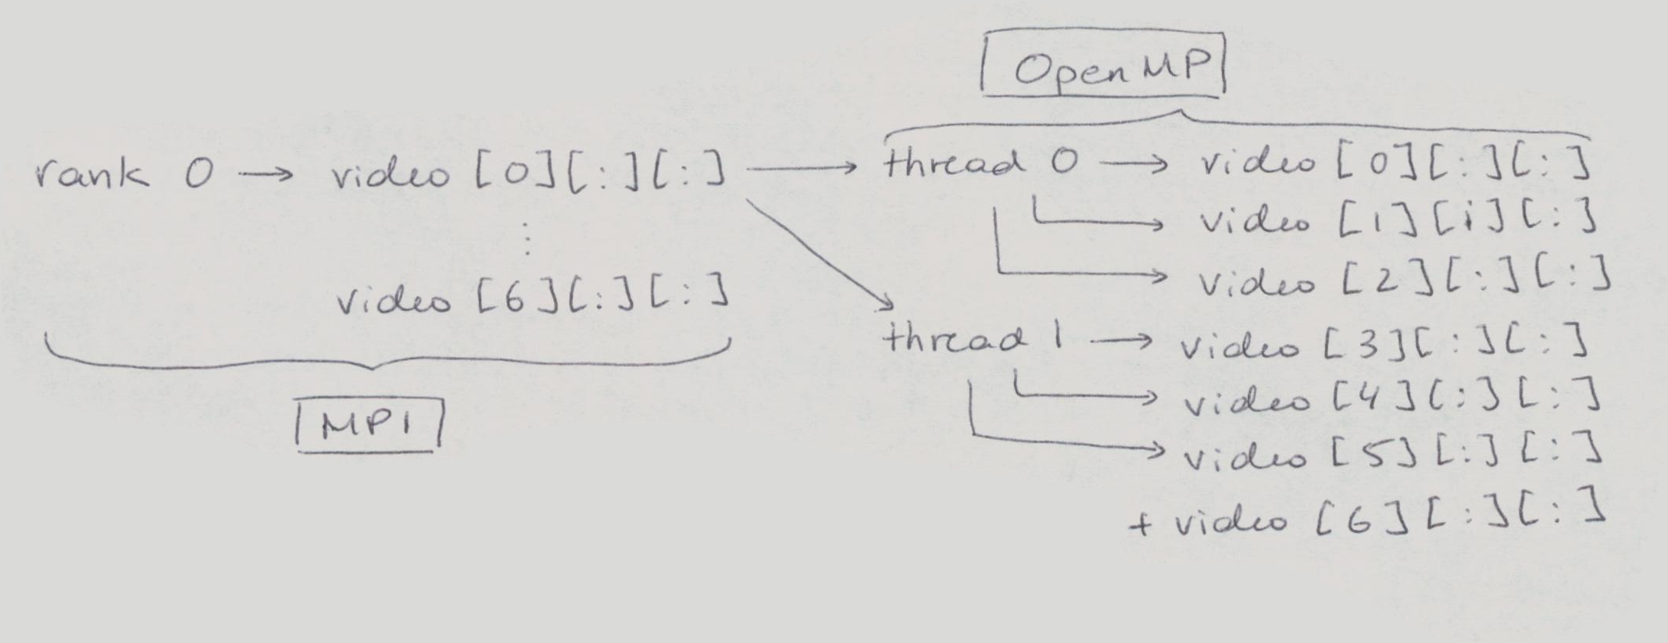
Partitioning between MPI + OpenMP

Slide 7
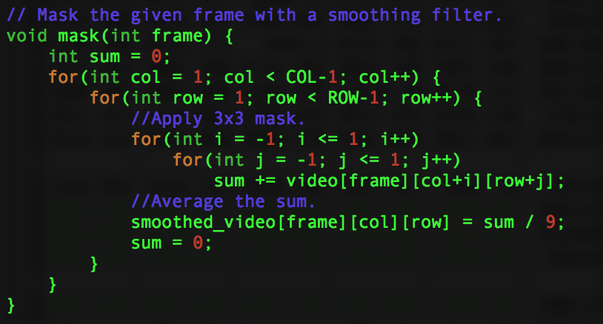
Smoothing images
Smoothing with constant mask:
|1 1 1|
1/9 * |1 1 1|
|1 1 1|
At every pixel. Ignore border.

Slide 8
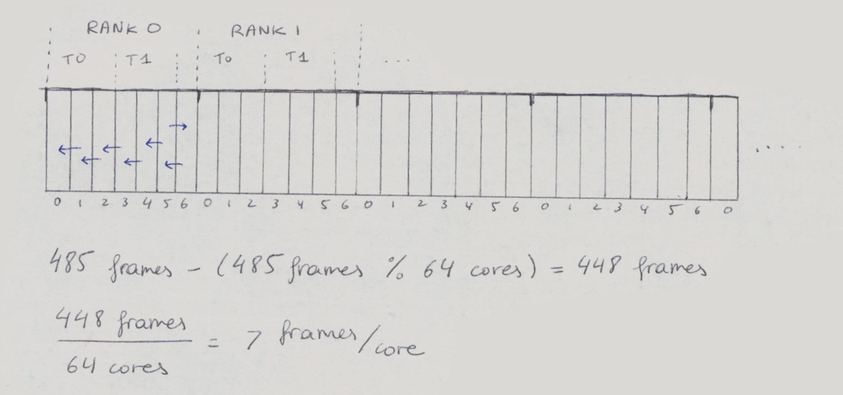
Temporal derivative

Slide 9
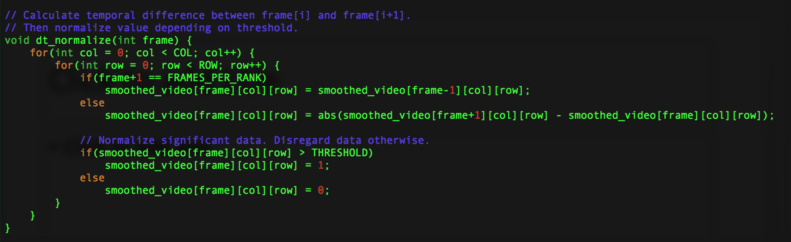
Temporal derivative + normalization

Slide 10
Results

Slide 11
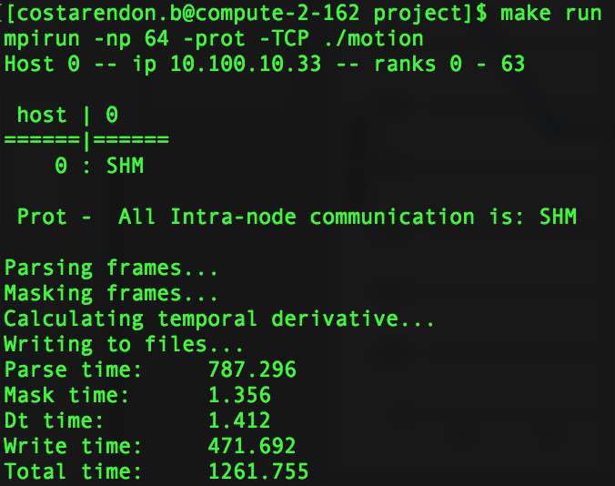
Console Results

Slide 12
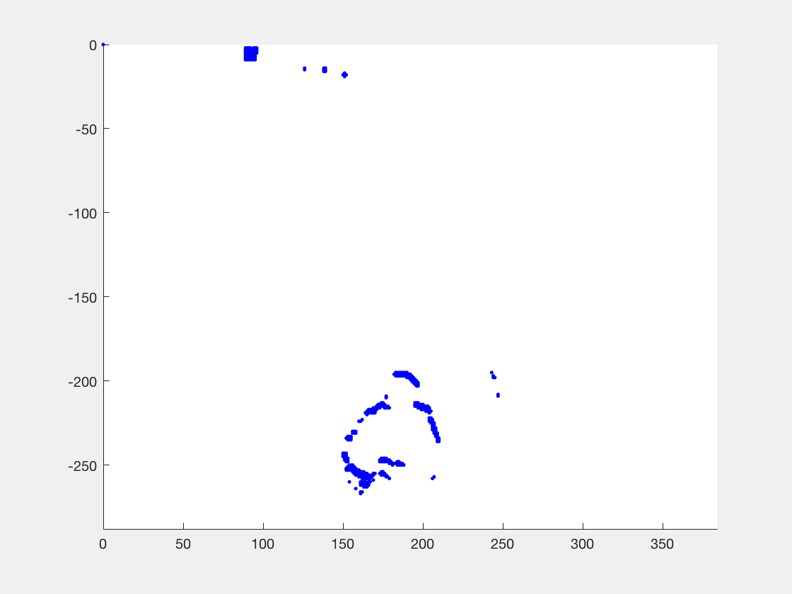
Motion detection scatter with MatLab

Slide 13
Project Objectives
Optimized number of cores.
Optimized number of threads.
Optimized workload per thread.
Exploit temporal locality.
Applied workload balances.
Optimized algorithm with less if statements.
Optimized spatial locality.
Optimized synchronization – by removing it.

Slide 14
References
LLNL OpenMP: https://computing.llnl.gov/tutorials/openMP/
LLNL MPI: https://computing.llnl.gov/tutorials/mpi/
Gather + Scattter Bottleneck: https://stackoverflow.com/questions/9269399/sending-blocks-of-2d-array-in-c-using-mpi/9271753#9271753
Contiguity: https://stackoverflow.com/questions/26998223/what-is-the-difference-between-contiguous-and-non-contiguous-arrays
MPI Error Table: https://www2.warwick.ac.uk/fac/sci/dcs/people/research/csrcbc/teaching/hpcseminars/seminars07/mpierrors/
How to allocate contiguous memory: https://stackoverflow.com/questions/5512245/mpi-scatter-sending-columns-of-2d-array
MPI Comm channels + gather + scatter: http://web.stanford.edu/class/cme213/files/lectures/Lecture_20.pdf

Slide 15
Thank you!

